Slide 1
SE-3002 Software Quality Engineering
Lecture 3-chapter 1
Overview and Basics
Alina Arshad
alina.arshad@nu.edu.pk

Slide 2
Quality Engineering
Different customers and users have different quality expectations under different market environments. Therefore, we need to move beyond just performing QA activities toward quality engineering by managing these quality expectations as an engineering problem.
Notes:
Some want a long-lasting battery.
Others prioritize a great camera.
Some prefer a budget-friendly option with basic features.

Slide 3
Software Quality Engineering
The application of a continuous, systematic, disciplined, quantifiable approach to the development and maintenance of quality throughout the whole life cycle of software products and systems; that is, the application of quality engineering to software

Slide 4
Quality Engineering: Activities and Process
There are three major groups of activities in the quality engineering process:
pre-QA activities, in-QA activities, and post-QA activities

Slide 5
Quality Engineering: Activities and Process
Pre-QA activities:
Quality planning
These are the activities that should be carried out before carrying out the regular QA activities. There are two major types of pre-QA activities in quality planning, including:
Set specific quality goals.
Form an overall QA strategy, which includes two sub-activities:
Select appropriate QA activities to perform.
Choose appropriate quality measurements and models
Notes:
quality goals are set on different quality views and attributes

Slide 6
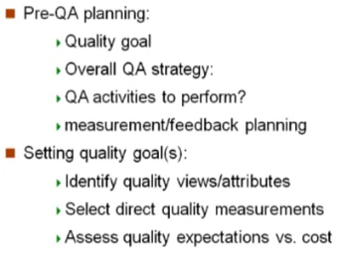
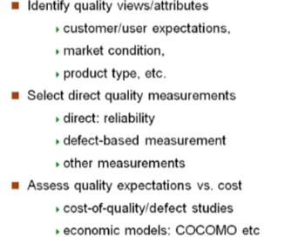
Pre-QA Planning

Slide 7
Quality Engineering: Activities and Process
In-QA activities:
Executing planned QA activities and handling discovered defects
In addition to performing selected QA activities, an important part of this normal execution is to deal with the discovered problems.

Slide 8
Quality Engineering: Activities and Process
Post-QA activities:
Quality measurement, assessment and improvement
The primary purpose of these activities is to provide quality assessment and feedback so that various management decisions can be made and possible quality improvement initiatives can be carried out
Short-term feedback
provides information for progress tracking, activity scheduling, and identification of areas that need special attentions
Long-term feedback
Feedback to quality planning so that necessary adjustment can be made to quality goals and QA strategies
Feedback to the quality assessment and improvement activities
Notes:
Short-term feedback helps with immediate fixes and adjustments.
Long-term feedback helps improve overall strategies and future processes.

Slide 9
Quality Engineering and Quality Improvement Paradigm (QIP)
The Quality Improvement Paradigm (QIP) suggests the following activities to achieve quality improvement
measurement, analysis, feedback
QIP includes three interconnected steps: understanding, assessing, and packaging, which form a feedback and improvement loop, as briefly described below:
The first step is to understand the baseline so that improvement opportunities can be identified and clear measurable goals can be set. All future process changes are measured against this baseline.
The second step is to introduce process changes through experiments, pilot projects, assess their impact, and fine tune these process changes.
The last step is to package baseline data, experiment results, local experience, and updated process as the way to infuse the findings of the improvement program into the development organization.

Slide 10
Quality Engineering in Software Process
The quality engineering process forms an integral part of the overall software engineering process, where other concerns, such as cost and schedule, are also considered and managed.
Individual QA activities can be carried out and integrated into the software process. When we broaden our scope to quality engineering, it also covers pre-QA quality planning as well as the post-QA measurement and analysis activities carried out parallel to and after QA activities to provide feedback and other useful information.
All these activities and the quality engineering process can be integrated into the overall software process.

Slide 11
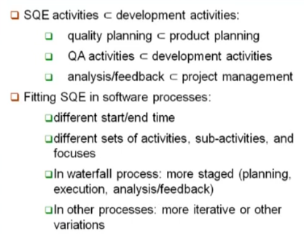
Quality Engineering in Software Process

Slide 12
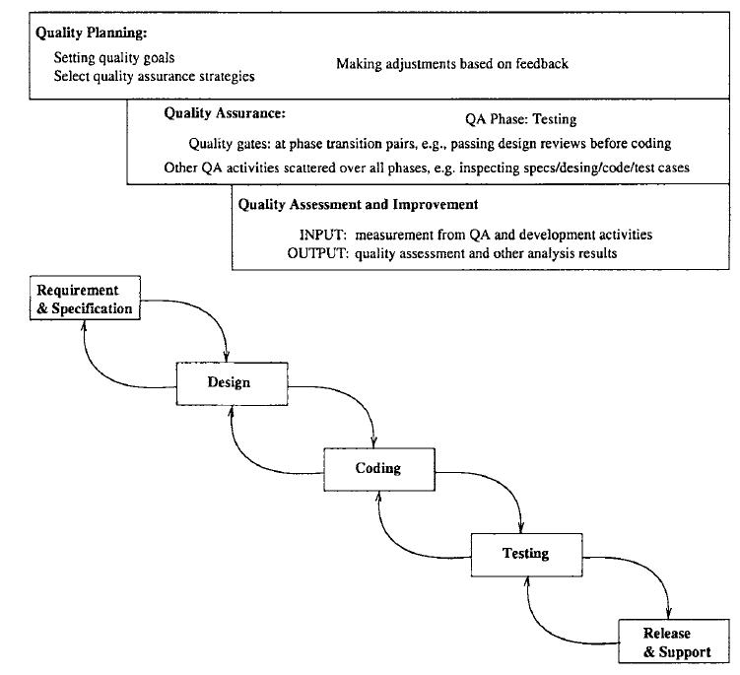
Quality Engineering in the Waterfall Process

Slide 13
Effort Profile
Among the three major types of activities in the quality engineering process, the execution of specific QA activities is central to dealing with defects and assuring quality for the software products. Therefore, they should and normally do consume the most resources in terms of human effort as well as utilization of computing and other related resources.
However, the effort distribution among the three is not constant over time because of the process characteristics described above and the shifting focus over time.

Slide 14
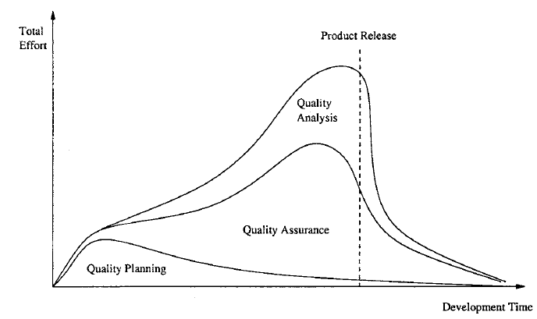
Effort Profile
The exact profile based on real data would not be as smooth and would naturally show large amount of variability, with many small peaks and valleys. But the general shape and pattern should preserve.

Slide 15
Effort Profile
Waterfall process would see more dominance of quality planning in the beginning, and dominance of testing near product release, and measurement and quality assessment activities peak right before product release.
Other development processes, such as incremental, iterative, spiral, and extreme programming processes, would be associated with curves that vary less between the peaks and valleys. QA is spread out more evenly in these processes than in the waterfall process, although it is still expected to peak a little bit before product release.

Slide 16
Concluding Remarks
To manage the quality assurance (QA) activities and to provide realistic opportunities of quantifiable quality improvement, we need to go beyond QA to perform the following:
Quality planning before specific QA activities are carried out, in the pre-QA activities in software quality engineering
Need to set the overall quality goal by managing customer’s quality expectations under the project cost and budgetary constraints
Quality quantification and improvement through measurement, analysis, feedback, and follow-up activities.
These activities need to be carried out after the start of specific QA activities, in the so-called post-QA activities in software quality engineering

Slide 17
SQA Tasks, Goals, Attributes, and Metrics
Software quality assurance (SQA) is a process which assures that all software engineering processes, methods, activities and work items are monitored and comply against the defined standards. These defined standards could be one or a combination of any like ISO 9000, CMMI (Capability Maturity Model Integration) model, ISO15504, etc.
A incorporates all software development processes starting from defining requirements to coding until release. Its prime goal is to ensure quality

Slide 18
SQA goals
Requirement quality : The correctness, completeness, and consistency of the requirements model will have a strong influence on the quality of all work products that follow. SQA must ensure that the software team has properly reviewed the requirements model to achieve a high level of quality.
Design quality : Every element of the design model should be assessed by the software team to ensure that it exhibits high quality and that the design itself conforms to requirements.

Slide 19
SQA goals
Code quality : Source code and related work products must conform to local coding standards and exhibit characteristics that will facilitate maintainability.
Quality control effectiveness : A software team should apply limited resources in a way that has the highest likelihood of achieving a high–quality result. SQA analyzes the allocation of resources for reviews and testing to assess whether they are being allocated in the most effective manner.

Slide 20
Software quality goals, attributes, and metrics
Goal | Attribute | Metric
Requirement quality | Ambigully | Number of ambiguous modifiers
 | Completeness | Number of TBA(to be announced) , TBD( to be determined)
 | Understandability | Number of sections/subsections
 | Volatility | Number of changes per requirement Time (by activity) when change is requested
 | Traceability | Number of requirements not traceable to design/code
 | Model clarity | Number of UML models Number of descriptive pages per model Number of UML errors

Slide 21
Software quality goals, attributes, and metrics
Design quality | Architectural integrity Component completeness Interface complexity Patterns | Existence of architectural model Number of components that trace to architectural model Complexity of procedural design Average number of pick to get to a typical function or content Layout appropriateness Number of patterns used

Slide 22
Software quality goals, attributes, and metrics
Code quality | Complexity Maintainability Understandability Reusability Documentation | Cyclomatic complexity Design factors Percent internal comments Variable naming conventions Percent reused components Readability index

Slide 23
Software quality goals, attributes, and metrics
QC effectiveness | Resource allocation Completion rate Testing effectiveness | Staff hour percentage per activity Actual vs. budgeted completion time Number of errors found and criticality Effort required to correct an error Origin of error

Slide 24
Any question????

